Slide 1

HPML Group 11/01/2023
Deep Learning
Language Modelling
Bryan Cardenas
Thomas van Osch
Vivian van Oijen

Slide 2
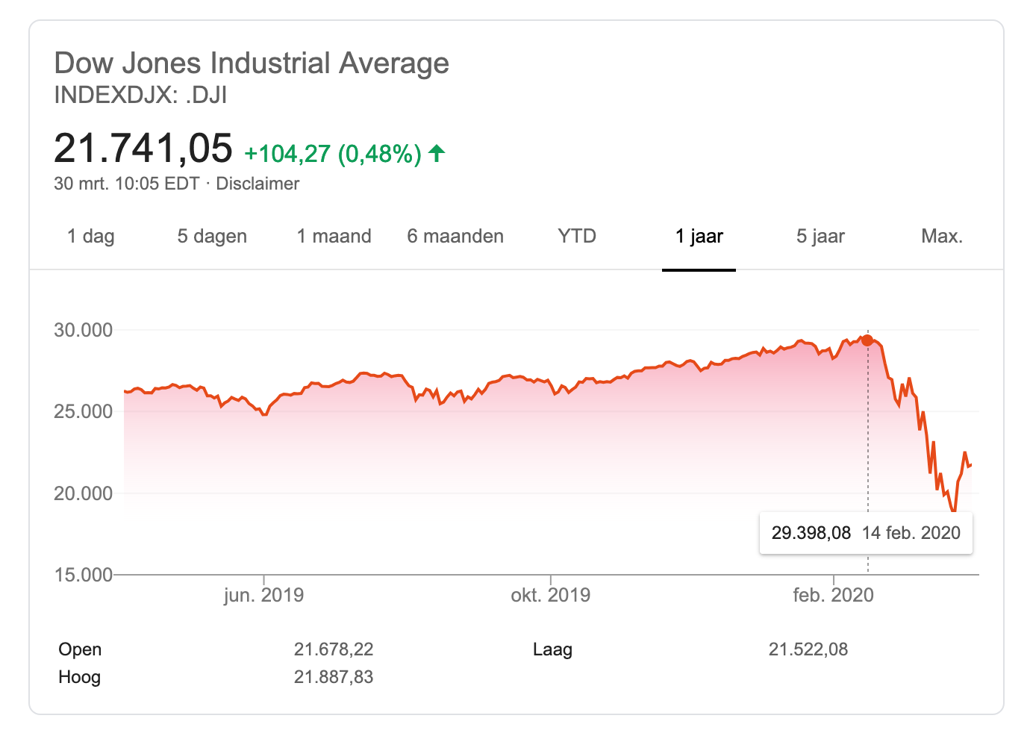
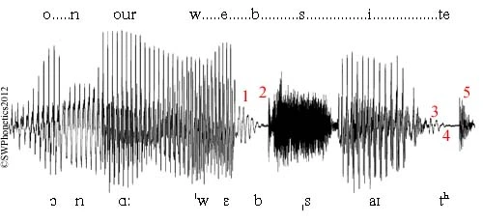
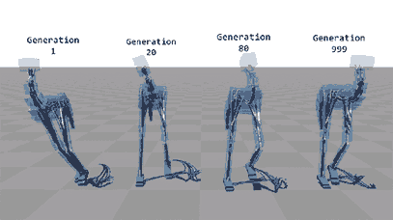
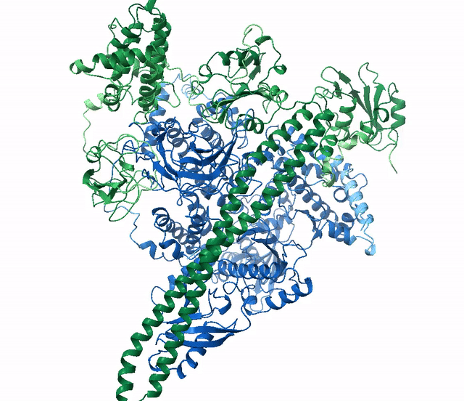
Sequential Data
Universe seems to be inherently sequential
We follow the arrow of time (no entropy reversals)

Slide 3
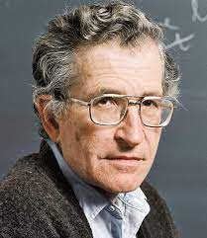
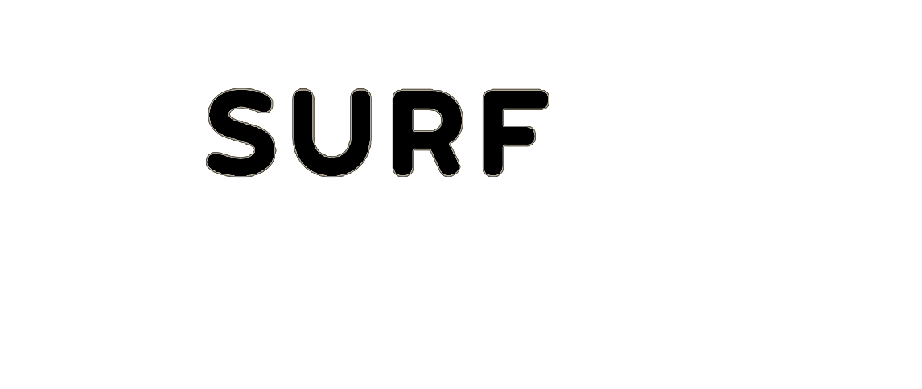
How Can we model this?
Is there one (sequential) model to rule them all?
Is modeling language difficult?
“
Language is a process of free creation; its laws and principles are fixed, but the manner in which the principles of generation are used is free and infinitely varied.
~ Noam Chomsky

Slide 4
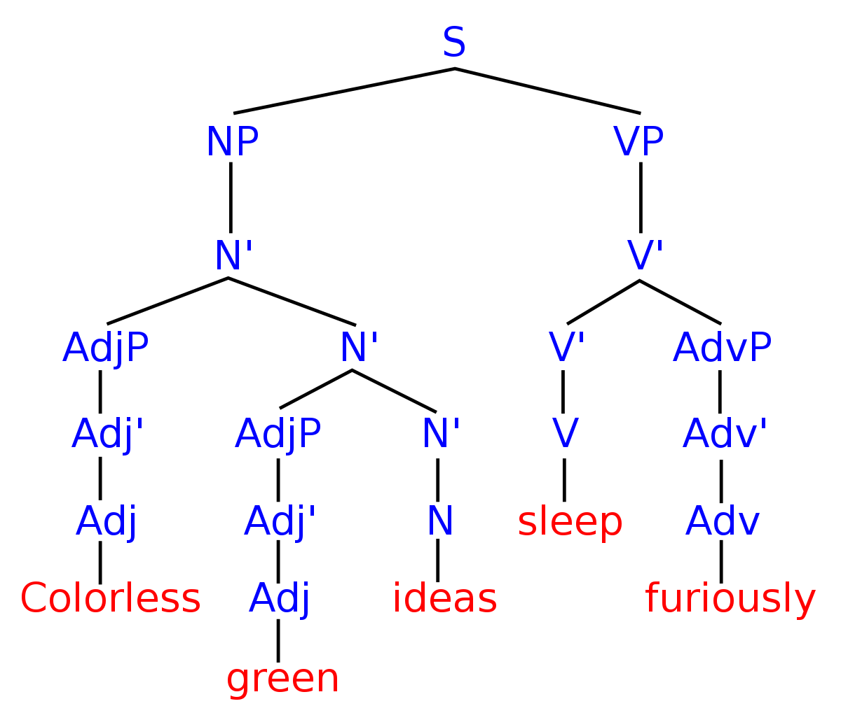
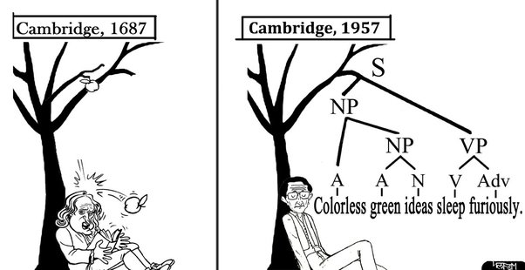
Sequential Data
Natural Language Modelling
Syntactic Structures
(Chomsky, N. 1957)

Slide 5
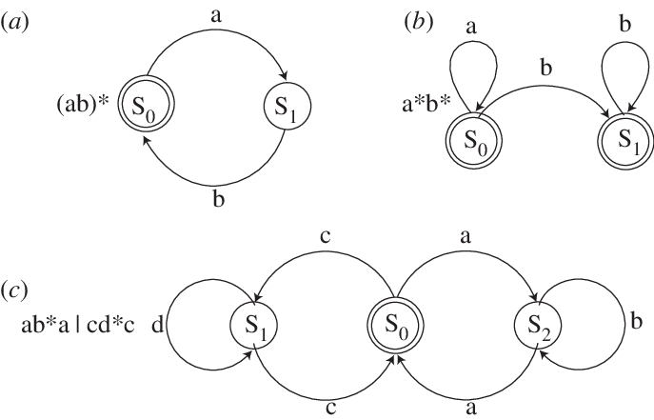
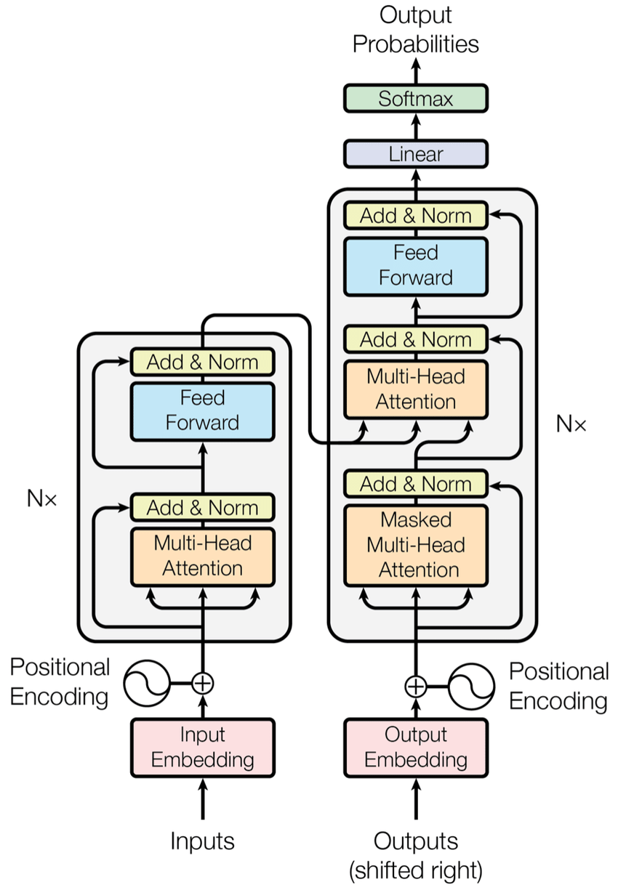
Sequential Data
Natural Language Modelling
We have the innate ability for language (Universal Grammar)
Different ways to model language
Finite State Automata
Generative Grammars
Deep Learning + Data

Slide 6
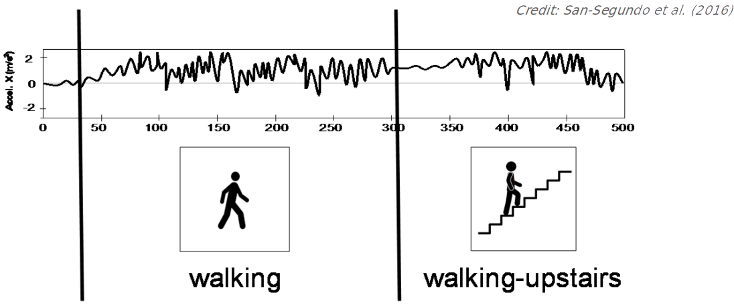
Human Activity Recognition

Slide 7
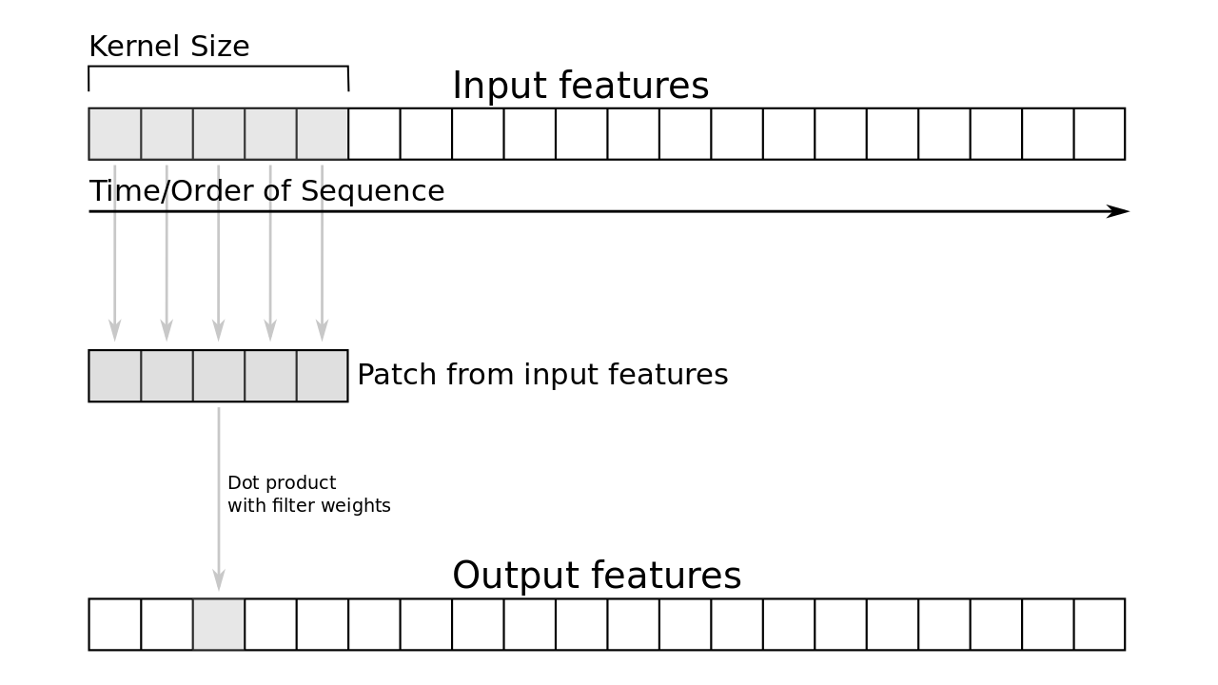
Human Activity Recognition
CNNs work here because they take into account nearby tokens
Use a CNN!

Slide 8
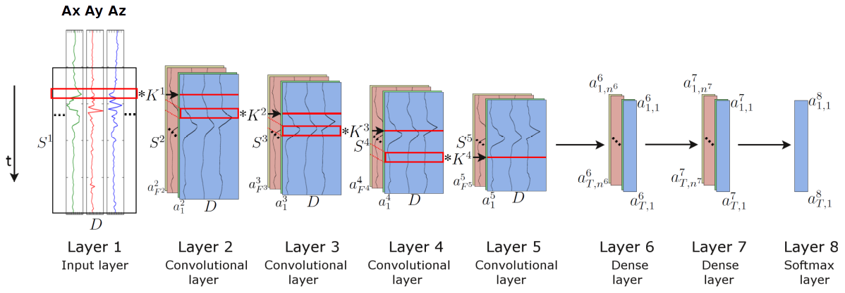
Human Activity Recognition
CNNs work here because they take into account nearby tokens
Use a CNN!

Slide 9
How to model Language?
LM objective:
Model the probability of the next word given the previous context

Slide 10
How to model Language?
Use a CNN?
NOPE
LM objective:
Model the probability of the next word given the previous context

Slide 11
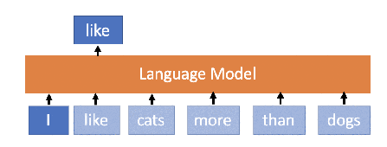

How to model Language?
Use a CNN?
NOPE
LM objective:
Model the probability of the next word given the previous context

Slide 12
How to model Language?
Use a CNN?
NOPE
LM objective:
Model the probability of the next word given the previous context
CNN’s context size is too small and does not remember past context
How to even represent language as a continuous signal?
Language is very noise and heavily (long-distance) context dependent

Slide 13
11/01/2023
The Transformer
High Performance Machine Learning Group

Slide 14
Transformers
Get rid of Recurrent Neural Networks
Instead of keeping one hidden state, keep track of multiple
What is the importance of every element in the input sequence with respect to itself?
Every word connected to every other word
More parallelization!
Self Attention

Slide 15
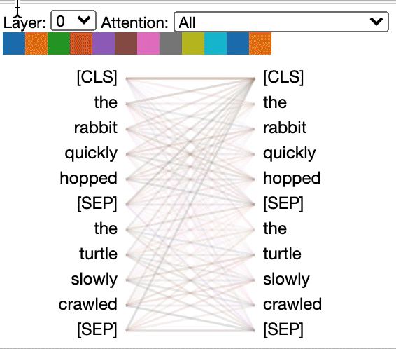
Transformers
Get rid of Recurrent Neural Networks
Instead of keeping one hidden state, keep track of multiple
What is the importance of every element in the input sequence with respect to itself?
Every word connected to every other word
More parallelization!
Self Attention

Slide 16
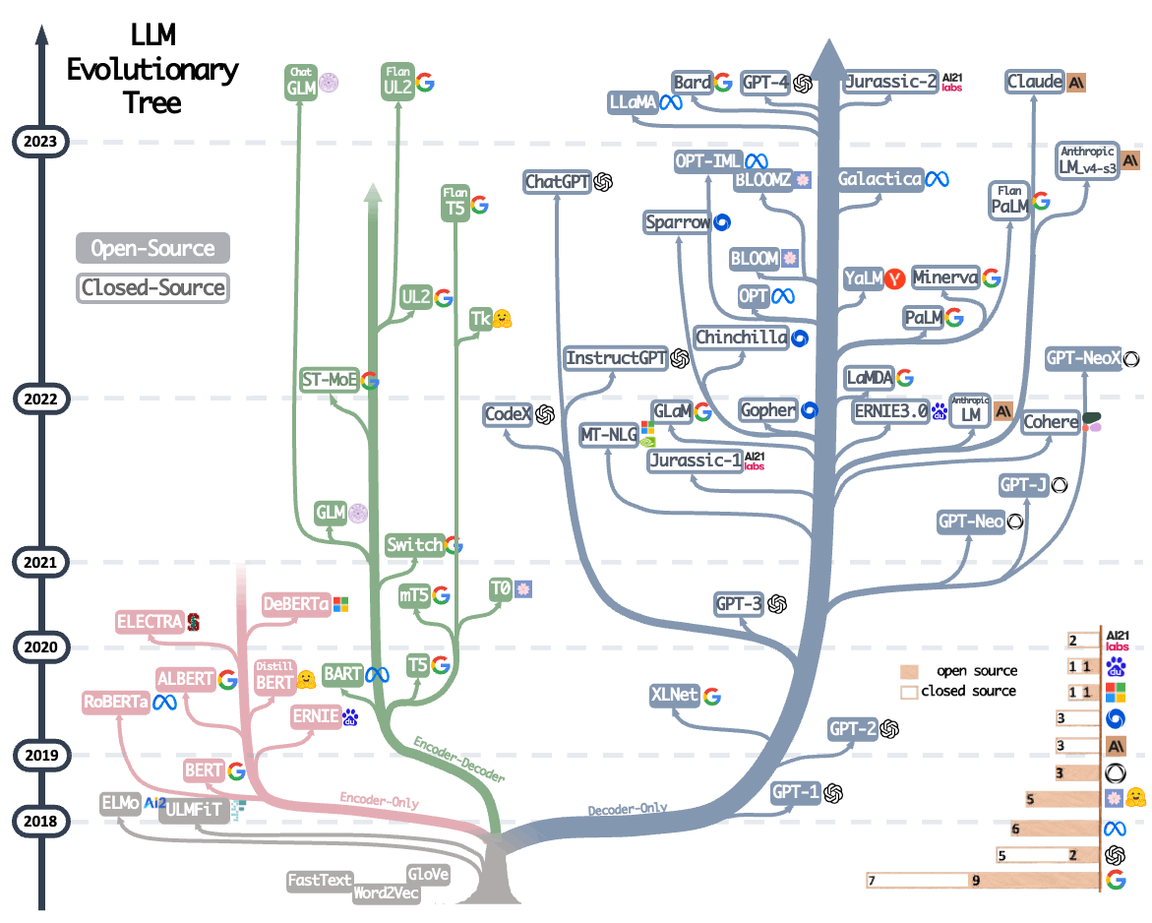
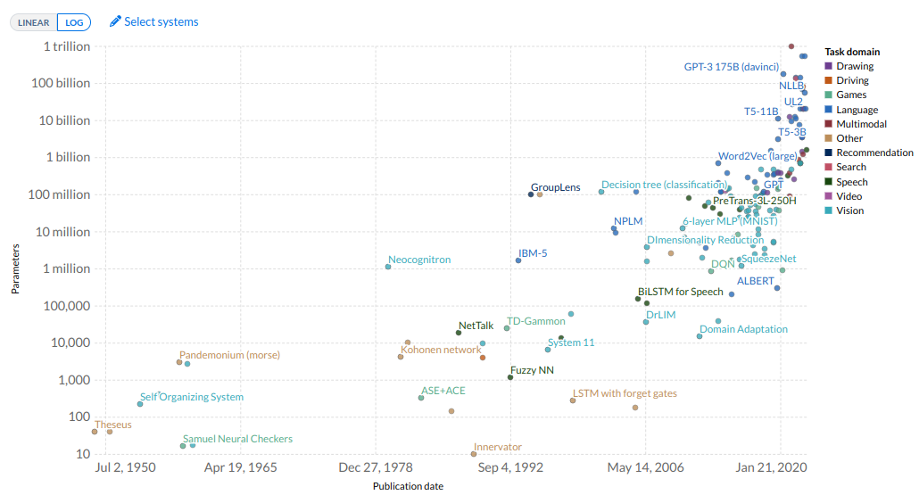
Cambrian Explosion of LMs

Slide 17
Dissection of the Transformer

Slide 18
Dissection of the Transformer

Slide 19
Dissection of the Transformer
01.
The Encoder

Slide 20
Dissection of the Transformer
01.
02.
The Encoder
The Decoder

Slide 21
Dissection of the Transformer
01.
02.
The Encoder
The Decoder

Slide 22
Dissection of the Transformer
01.
02.
The Encoder
The Decoder
Input Embeddings

Slide 23
Dissection of the Transformer
01.
02.
The Encoder
The Decoder
Self-Attention Input Embeddings

Slide 24
Dissection of the Transformer
01.
02.
The Encoder
The Decoder
Self-Attention Input Embeddings
Layer Normalization
Skip Connections
Positional Encoding
Byte Pair Encodings
Layer Stacking
Cross Attention

Slide 25
11/01/2023
Neural Representations
High Performance Machine Learning Group

Slide 26
How do we represent words?
Language is discrete!
“
One cat ate a tuna, one cat ate a chicken, one weird cat ate a human.

Slide 27
How do we represent words?
Language is discrete!
“
One cat ate a tuna, one cat ate a chicken, one weird cat ate a human.

Slide 28
How do we represent words?
Language is discrete!
Vocabulary
A vocabulary is the set of unique tokens in your language (dataset)
“
One cat ate a tuna, one cat ate a chicken, one weird cat ate a human.

Slide 29
How do we represent words?
Language is discrete!
Vocabulary
A vocabulary is the set of unique tokens in your language (dataset)
“
One cat ate a tuna, one cat ate a chicken, one weird cat ate a human.

Slide 30
How do we represent words?
Language is discrete!
Vocabulary
one
cat
ate
tuna
chicken
weird
human
a
A vocabulary is the set of unique tokens in your language (dataset)
“
One cat ate a tuna, one cat ate a chicken, one weird cat ate a human.

Slide 31
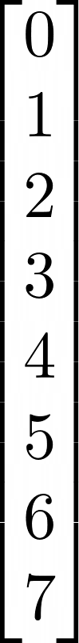
How do we represent words?
Language is discrete!
Vocabulary
one
cat
ate
tuna
chicken
weird
human
a
A vocabulary is the set of unique tokens in your language (dataset)
“
One cat ate a tuna, one cat ate a chicken, one weird cat ate a human.

Slide 32
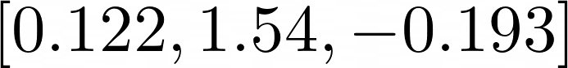
How do we represent words?
Language is discrete!
Vocabulary
one
cat
ate
tuna
chicken
weird
human
a
A vocabulary is the set of unique tokens in your language (dataset)
“
One cat ate a tuna, one cat ate a chicken, one weird cat ate a human.

Slide 33
How do we represent words?
Language is discrete!
Vocabulary
one
cat
ate
tuna
chicken
weird
human
a
A vocabulary is the set of unique tokens in your language (dataset)
“
One cat ate a tuna, one cat ate a chicken, one weird cat ate a human.
Easy to compose and easy to vectorize

Slide 34
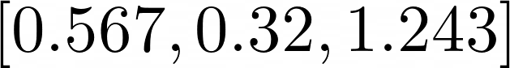
How do we represent words?
Language is discrete!
Vocabulary
one
cat
ate
tuna
chicken
weird
human
a
A vocabulary is the set of unique tokens in your language (dataset)
“
One cat ate a tuna, one cat ate a chicken, one weird cat ate a human.
Easy to compose and easy to vectorize

Slide 35
How do we represent words?
Language is discrete!
Vocabulary
one
cat
ate
tuna
chicken
weird
human
a
A vocabulary is the set of unique tokens in your language (dataset)
Embedding
“
One cat ate a tuna, one cat ate a chicken, one weird cat ate a human.
Easy to compose and easy to vectorize

Slide 36
Neural Representation Learning
King
Man

Slide 37
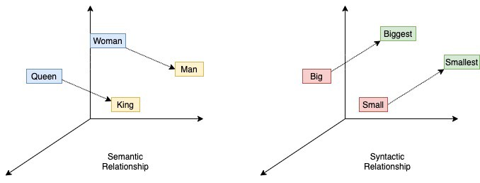
Neural Representation Learning
King
Man

Slide 38
Neural Representation Learning
King
Man
King - Man + Woman = Queen
Each word has a numerical vector representation
learnt by a language model

Slide 39
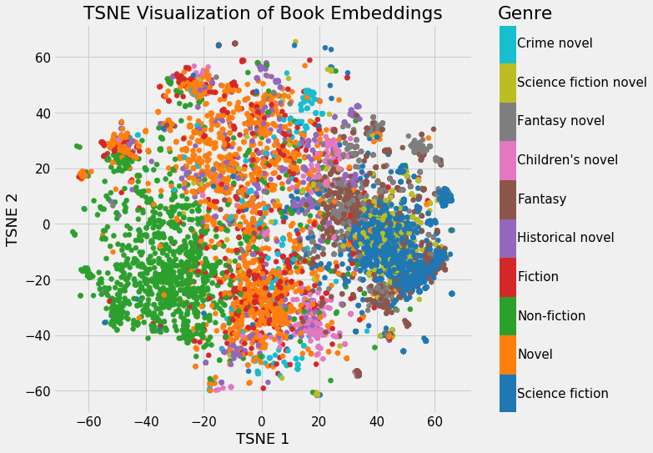
Neural Representation Learning
King - Man + Woman = Queen
Each word has a numerical vector representation
learnt by a language model

Slide 40
11/01/2023
Self Attention
High Performance Machine Learning Group

Slide 41

Self Attention

Slide 42
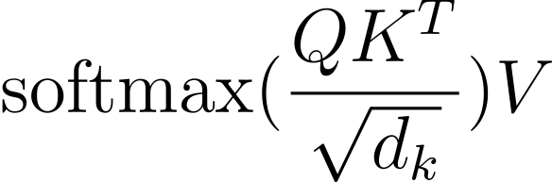
Self Attention

Slide 43
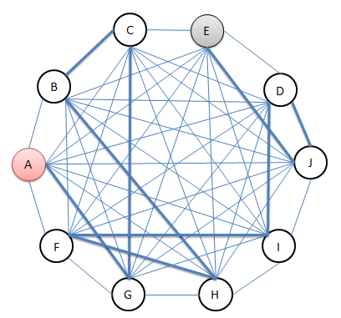
Self Attention

Slide 44
Self Attention

Slide 45
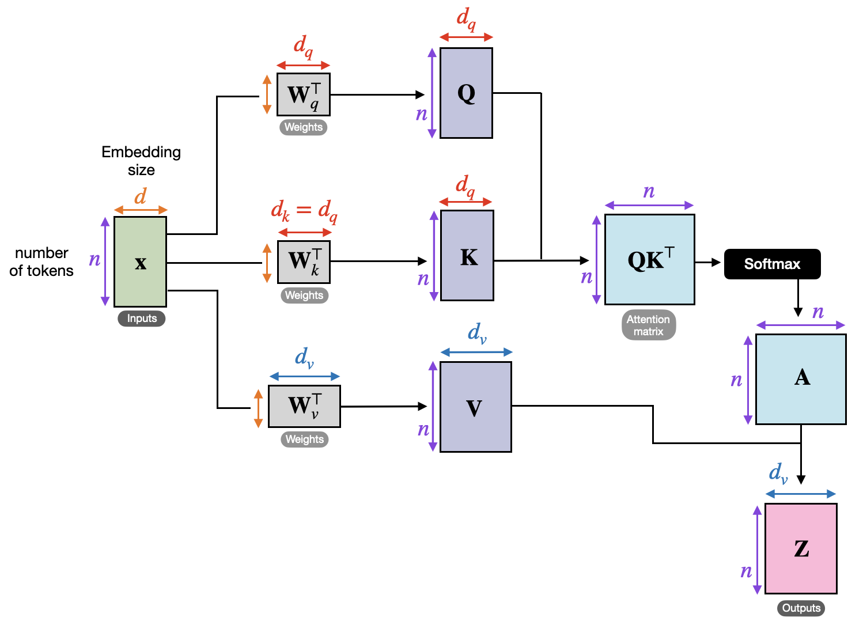
Self Attention

Slide 46
Self Attention

Slide 47
Self Attention

Slide 48
Self Attention

Slide 49
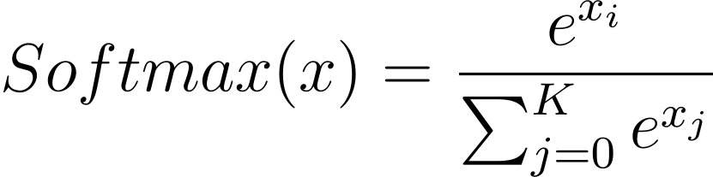
Self Attention

Slide 50
Self Attention

Slide 51

Self Attention

Slide 52
Self Attention

Slide 53
Self Attention

Slide 54
Self Attention

Slide 55
11/01/2023
Multi-Head Attention
High Performance Machine Learning Group

Slide 56
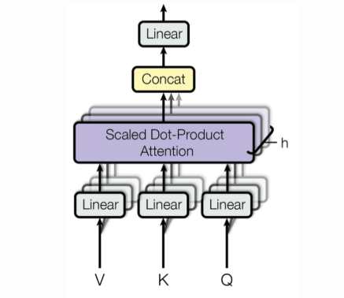
The Multi-Headed Beast
Voita, Elena et al. “Analyzing Multi-Head Self-Attention: Specialized Heads Do the Heavy Lifting, the Rest Can Be Pruned.”
Stack Self-Attention heads to extract multiple features

Slide 57
The Multi-Headed Beast
Voita, Elena et al. “Analyzing Multi-Head Self-Attention: Specialized Heads Do the Heavy Lifting, the Rest Can Be Pruned.”
Stack Self-Attention heads to extract multiple features
“
Analyzing Multi-Head Self-Attention: Specialized Heads Do the Heavy Lifting, the Rest Can Be Pruned

Slide 58
The Multi-Headed Beast
Voita, Elena et al. “Analyzing Multi-Head Self-Attention: Specialized Heads Do the Heavy Lifting, the Rest Can Be Pruned.”
Stack Self-Attention heads to extract multiple features
“
Analyzing Multi-Head Self-Attention: Specialized Heads Do the Heavy Lifting, the Rest Can Be Pruned
Each head could focus on
Syntax
Positions
Rare words
Grammatical Errors
N-grams

Slide 59
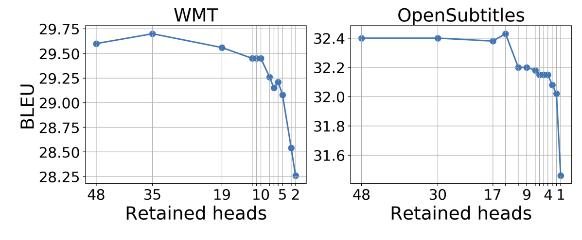
The Multi-Headed Beast
Voita, Elena et al. “Analyzing Multi-Head Self-Attention: Specialized Heads Do the Heavy Lifting, the Rest Can Be Pruned.”
Stack Self-Attention heads to extract multiple features
“
Analyzing Multi-Head Self-Attention: Specialized Heads Do the Heavy Lifting, the Rest Can Be Pruned
Each head could focus on
Syntax
Positions
Rare words
Grammatical Errors
N-grams

Slide 60
The Multi-Headed Beast
Stack Self-Attention heads to extract multiple features
“
Analyzing Multi-Head Self-Attention: Specialized Heads Do the Heavy Lifting, the Rest Can Be Pruned
Transformers are Permutation Invariant!

Slide 61
The Multi-Headed Beast
Stack Self-Attention heads to extract multiple features
“
Analyzing Multi-Head Self-Attention: Specialized Heads Do the Heavy Lifting, the Rest Can Be Pruned
Transformers are Permutation Invariant!

Slide 62

The Multi-Headed Beast
Stack Self-Attention heads to extract multiple features
“
Analyzing Multi-Head Self-Attention: Specialized Heads Do the Heavy Lifting, the Rest Can Be Pruned
Transformers are Permutation Invariant!

Slide 63
The Multi-Headed Beast
Stack Self-Attention heads to extract multiple features
“
Analyzing Multi-Head Self-Attention: Specialized Heads Do the Heavy Lifting, the Rest Can Be Pruned
Transformers are Permutation Invariant!

Slide 64
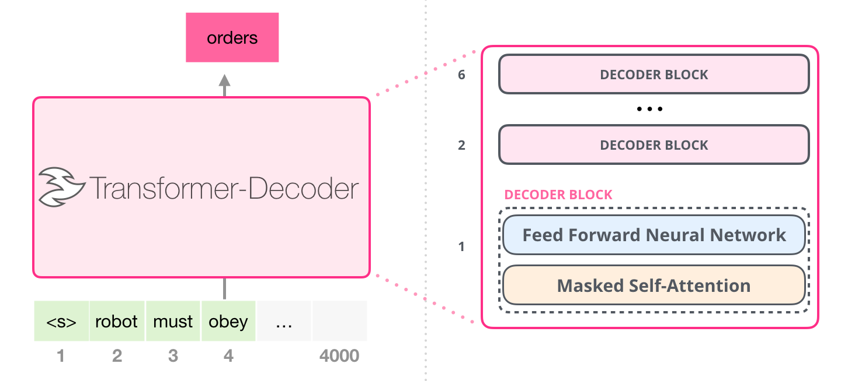
The Multi-Headed Beast
Stack Self-Attention heads to extract multiple features
“
Analyzing Multi-Head Self-Attention: Specialized Heads Do the Heavy Lifting, the Rest Can Be Pruned
Transformers are Permutation Invariant!

Slide 65
Dissection of the Transformer
The Encoder
The Decoder
BERT
GPT

Slide 66
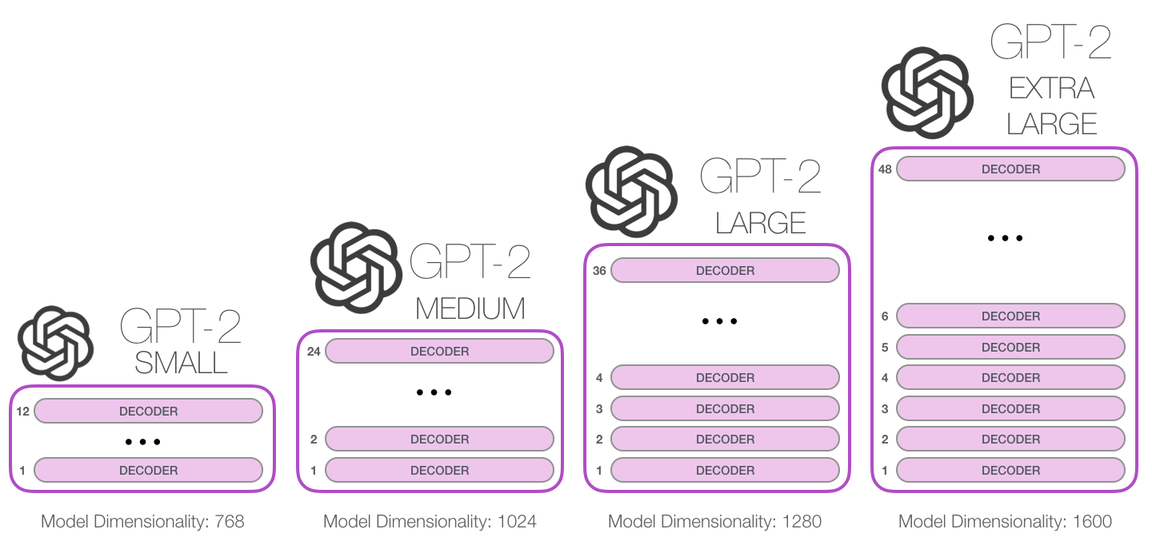
Generative Pre-Trained Transformers

Slide 67
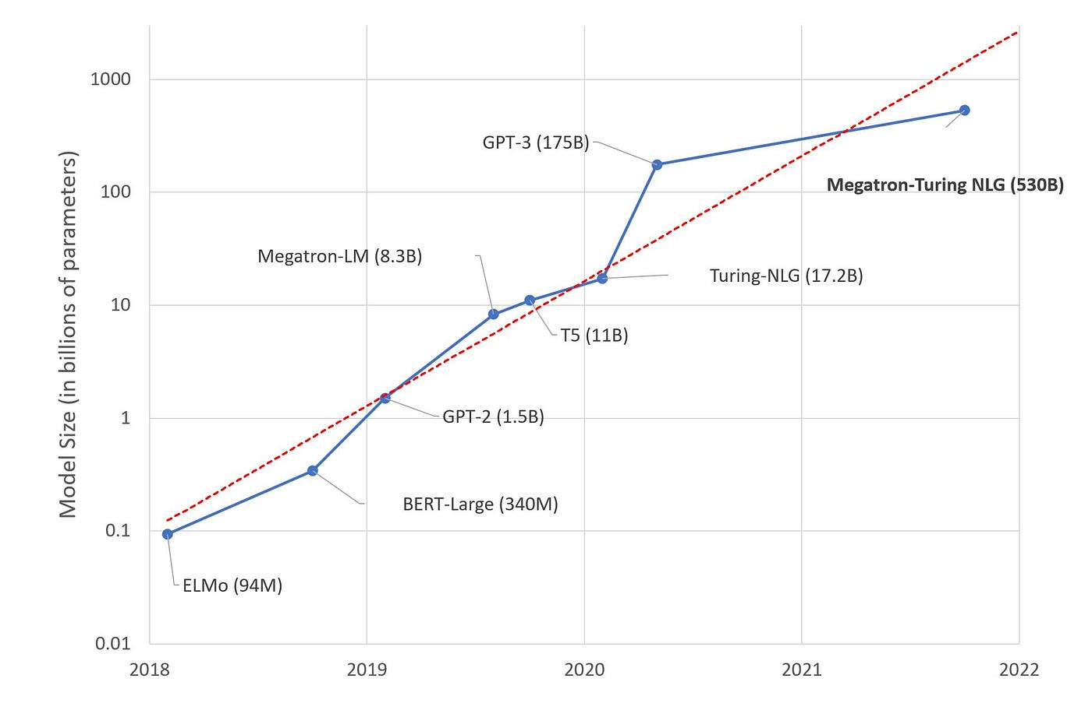
Generative Pre-Trained Transformers

Slide 68
11/01/2023
Transformer Cases
High Performance Machine Learning Group

Slide 69
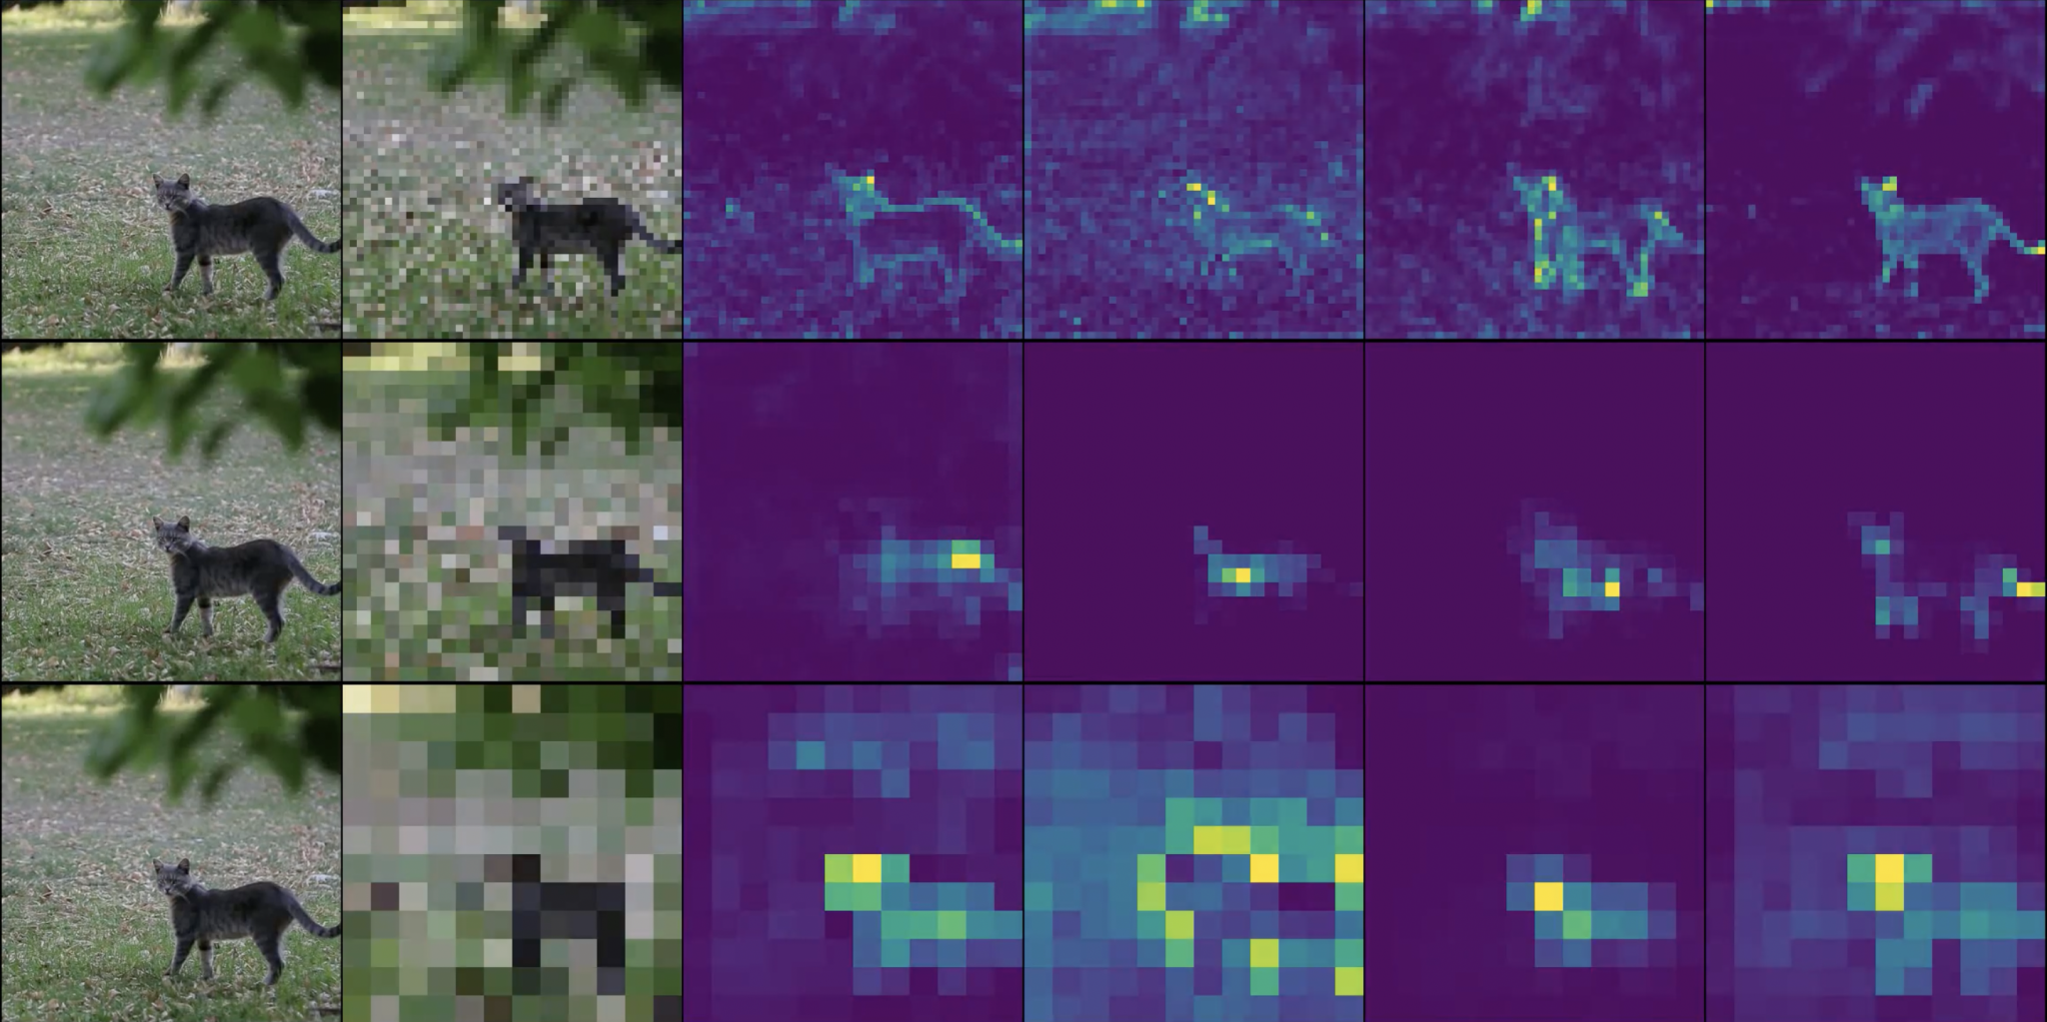
Transformers for other modalities: ViT

Slide 70
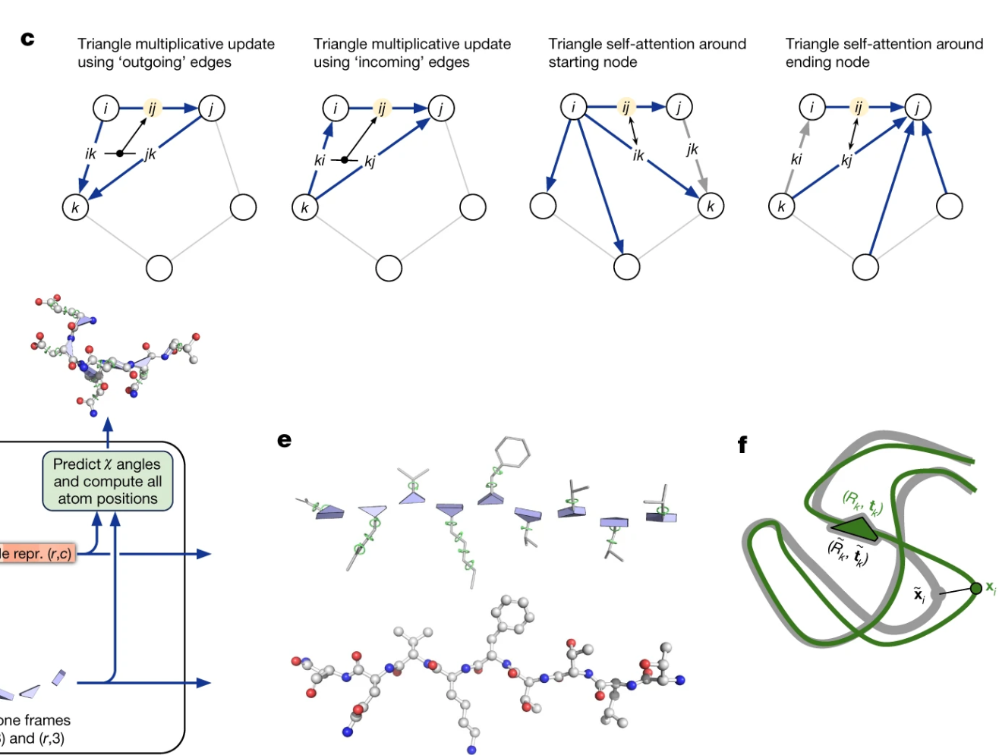
Transformers for other modalities: EvoFormer
https://www.nature.com/articles/s41586-021-03819-2

Slide 71
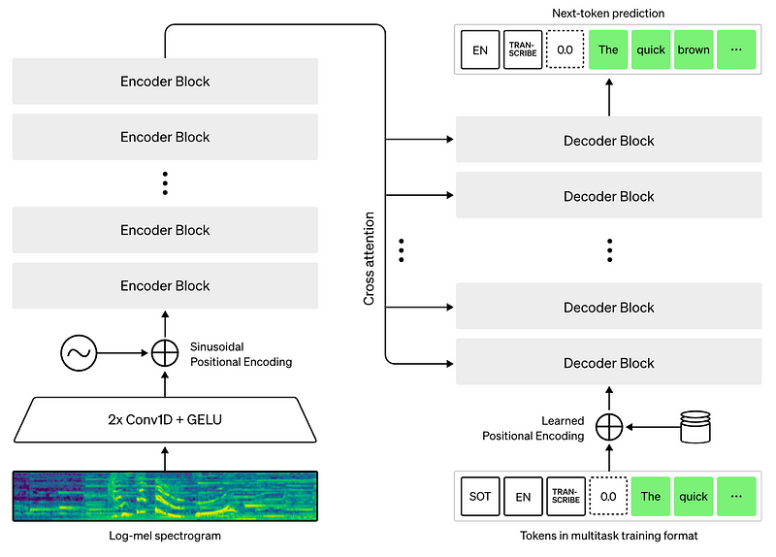
Transformers for other modalities: Whisper
Transformers for other modalities: Whisper
https://openai.com/research/whisper

Slide 72

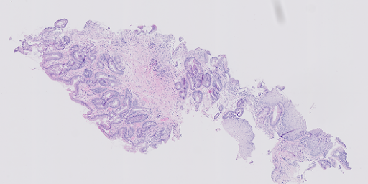
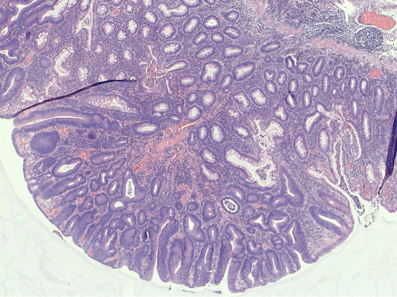
Transformers for other modalities: Whisper
Transformers for other modalities: Multi-Modal Histopathology
The
quick
brown
…
WSIs
Decoder Block
Transformer
WSI
Encoder
cross-attention
HIPT
Decoder Block
Decoder Block
BIO-GPT-2
SOT
The
quick
brown
…
Caption generation from histopathology whole-slide images using pre-trained transformers
BC Guevara, N Marini, S Marchesin, W Aswolinskiy, et al.

Slide 73
11/01/2023
Transformer Interpretations
High Performance Machine Learning Group

Slide 74
Fully Connected Weighted Graph
Lower the energy state that the network should remember

Slide 75
Modify the input layer by layer
Lower the energy state that the network should remember
https://transformer-circuits.pub/2021/framework/index.html
Belrose, Nora et al. “Eliciting Latent Predictions from Transformers with the Tuned Lens.”

Slide 76
Modify the input layer by layer
Lower the energy state that the network should remember
Attention heads output a result added to the residual stream.
All components of a transformer communicate by reading and writing to different subspaces of the stream
https://transformer-circuits.pub/2021/framework/index.html
Belrose, Nora et al. “Eliciting Latent Predictions from Transformers with the Tuned Lens.”

Slide 77
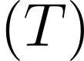
Modify the input layer by layer
Lower the energy state that the network should remember
Attention heads output a result added to the residual stream.
All components of a transformer communicate by reading and writing to different subspaces of the stream
Conveyor belt principle
https://transformer-circuits.pub/2021/framework/index.html
Belrose, Nora et al. “Eliciting Latent Predictions from Transformers with the Tuned Lens.”

Slide 78
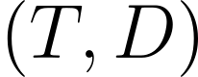
Modify the input layer by layer
Lower the energy state that the network should remember
Attention heads output a result added to the residual stream.
All components of a transformer communicate by reading and writing to different subspaces of the stream
Conveyor belt principle
https://transformer-circuits.pub/2021/framework/index.html
Belrose, Nora et al. “Eliciting Latent Predictions from Transformers with the Tuned Lens.”

Slide 79
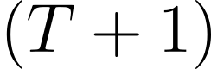
Modify the input layer by layer
Lower the energy state that the network should remember
Attention heads output a result added to the residual stream.
All components of a transformer communicate by reading and writing to different subspaces of the stream
Conveyor belt principle
https://transformer-circuits.pub/2021/framework/index.html
Belrose, Nora et al. “Eliciting Latent Predictions from Transformers with the Tuned Lens.”

Slide 80
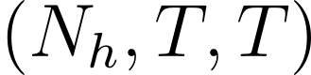
Modify the input layer by layer
Lower the energy state that the network should remember
Attention heads output a result added to the residual stream.
All components of a transformer communicate by reading and writing to different subspaces of the stream
Conveyor belt principle
https://transformer-circuits.pub/2021/framework/index.html
Belrose, Nora et al. “Eliciting Latent Predictions from Transformers with the Tuned Lens.”

Slide 81
Modify the input layer by layer
Lower the energy state that the network should remember
Attention heads output a result added to the residual stream.
All components of a transformer communicate by reading and writing to different subspaces of the stream
Conveyor belt principle
https://transformer-circuits.pub/2021/framework/index.html
Belrose, Nora et al. “Eliciting Latent Predictions from Transformers with the Tuned Lens.”

Slide 82
Final Words
Transformer training is quite slow
We need a lot of data
And a lot of parameters
Rabe, Markus N. and Charles Staats. “Self-attention Does Not Need O(n2) Memory.” ArXiv abs/2112.05682 (2021): n. pag.

Slide 83
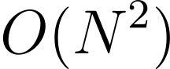
Final Words
Transformer training is quite slow
We need a lot of data
And a lot of parameters
in compute and memory
Rabe, Markus N. and Charles Staats. “Self-attention Does Not Need O(n2) Memory.” ArXiv abs/2112.05682 (2021): n. pag.

Slide 84
Final Words
Transformer training is quite slow
We need a lot of data
And a lot of parameters
in compute and memory
But, does not have to be
In memory!
Rabe, Markus N. and Charles Staats. “Self-attention Does Not Need O(n2) Memory.” ArXiv abs/2112.05682 (2021): n. pag.

Slide 85
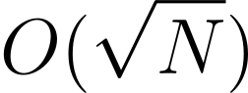
Final Words
Transformer training is quite slow
We need a lot of data
And a lot of parameters
in compute and memory
But, does not have to be
In memory!
We can do
Partition the attention and compute it chunk by chunk
Uses more compute but orders of magnitude less memory usage
Rabe, Markus N. and Charles Staats. “Self-attention Does Not Need O(n2) Memory.” ArXiv abs/2112.05682 (2021): n. pag.

Slide 86
11/01/2023
Chinchilla Scaling Laws
High Performance Machine Learning Group

Slide 87
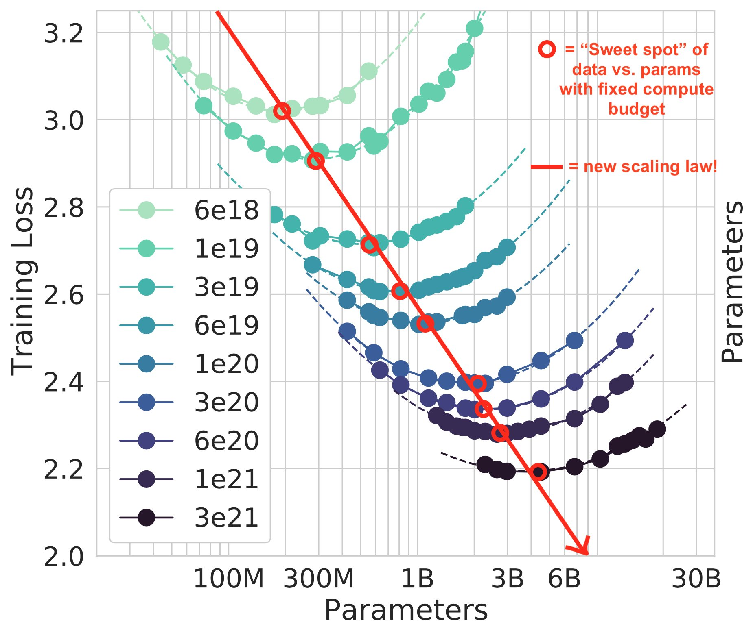
Transformers for other modalities: Whisper
Chinchilla Scaling Laws
Hoffmann, Jordan et al. “Training Compute-Optimal Large Language Models.” ArXiv abs/2203.15556 (2022): n. pag.

Slide 88
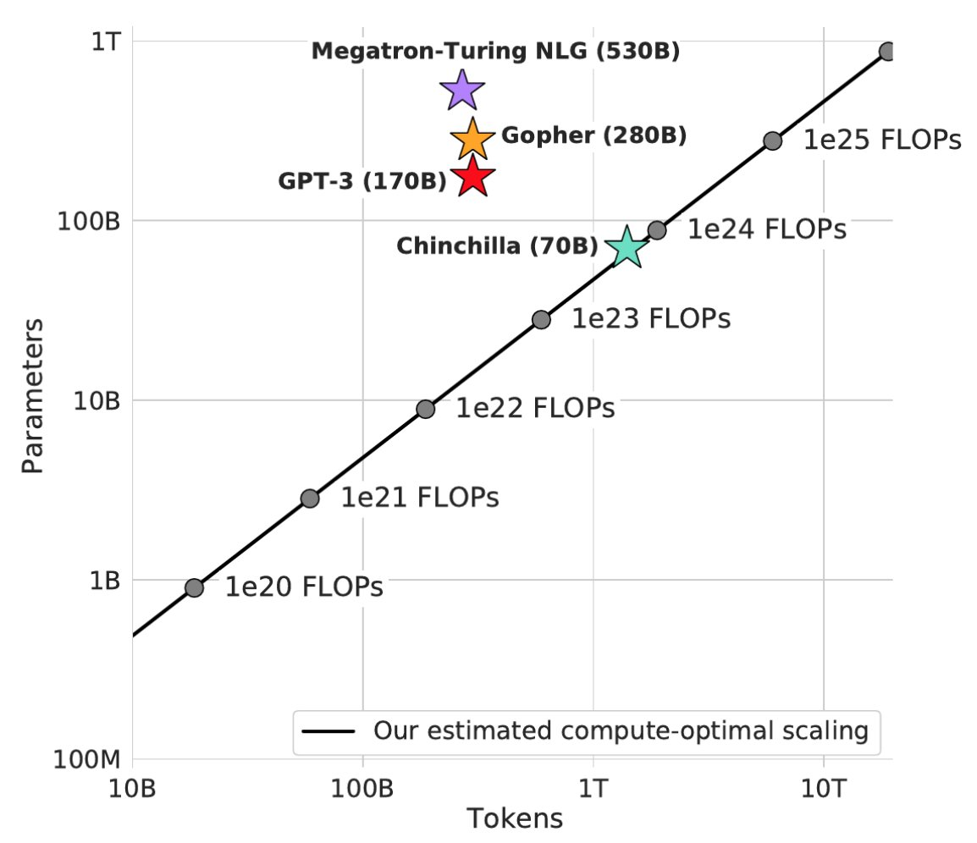
Transformers for other modalities: Whisper
Chinchilla Scaling Laws
Hoffmann, Jordan et al. “Training Compute-Optimal Large Language Models.” ArXiv abs/2203.15556 (2022): n. pag.

Slide 89
11/01/2023
Transformer Demo
High Performance Machine Learning Group

Slide 90
11/01/2023
Scaling Transformers
High Performance Machine Learning Group

Slide 91
Whose Revolution?
01.
02.
03.
04.
Data Amount &
Availability
Data generated by our devices continuously
Compute Power
Easier available in the cloud
Frameworks to work with
accelerated hardware
Research & Funds
More funds to researchers to experiment without limits
More Parameters
Make networks bigger
Feed more information

Slide 92
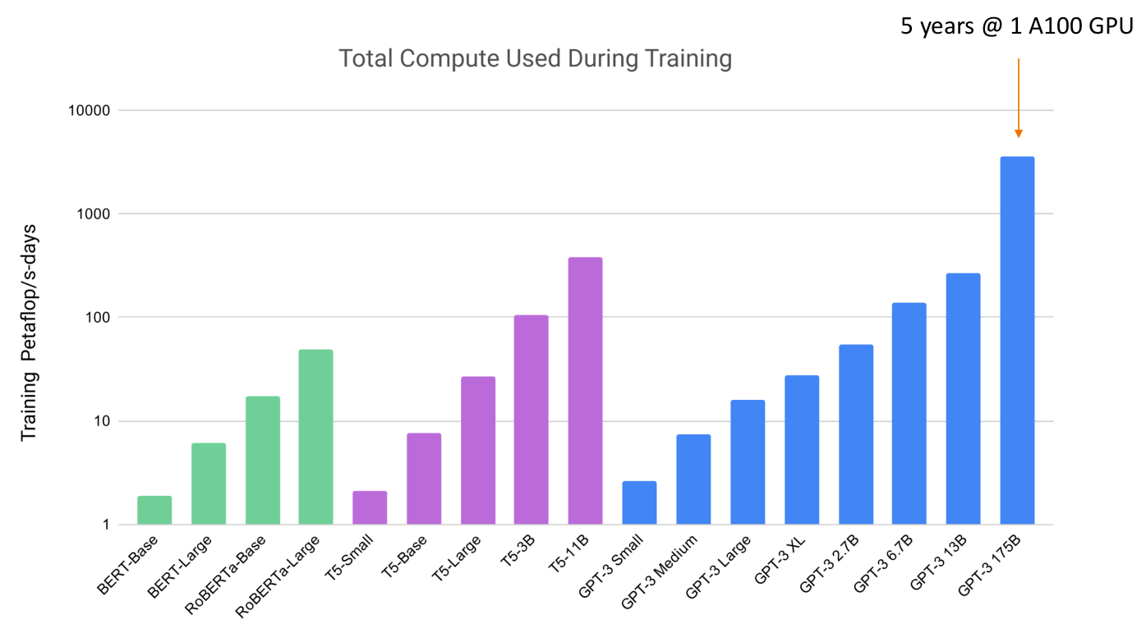
Transformer Explosion
GPT-3 Trained on ~350 Billion tokens
GPT-3 has 175B parameters!
OpenAI used a cluster of V100 GPUs
~Newest iterations trained on 1024 A100s for 34 days

Slide 93

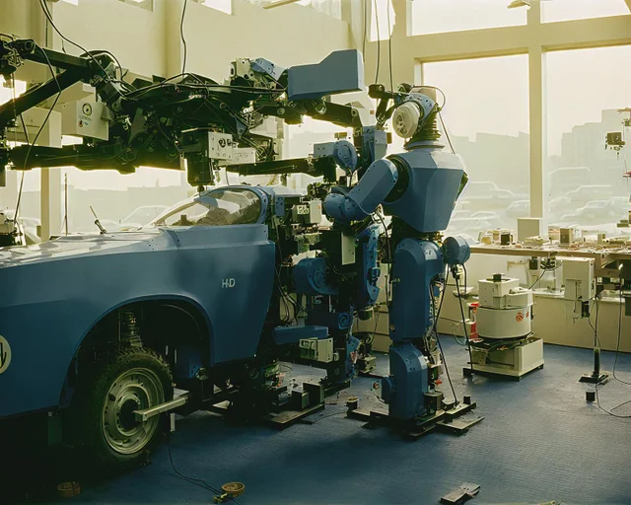


Stable Diffusion & DALLE
Trained on 500M+ image and text pairs
Stability AI used over 4000 A100 GPUs

Slide 94
Stable Diffusion & DALLE
Trained on 500M+ image and text pairs
Stability AI used over 4000 A100 GPUs
Training Large Language Models can consume a few hundreds or even thousands of MWh of energy
A GPU can consume around 400W at peak or more

Slide 95
Stable Diffusion & DALLE
Trained on 500M+ image and text pairs
Stability AI used over 4000 A100 GPUs
Training Large Language Models can consume a few hundreds or even thousands of MWh of energy
A GPU can consume around 400W at peak or more
Brain is vastly more efficient consuming around 10W

Slide 96
HPML Group 11/01/2023
Fin
Introduction Series
Bryan Cardenas
Thomas van Osch

